Slide 1
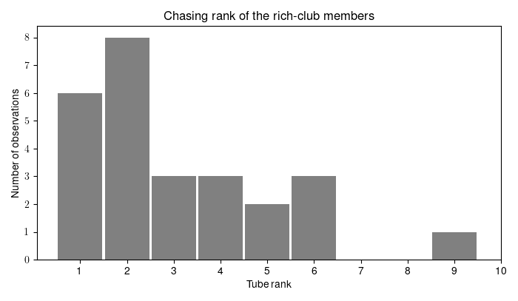
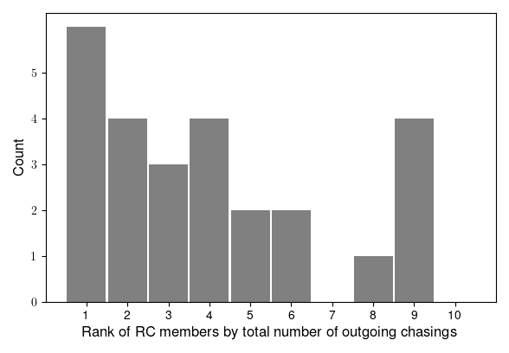

Slide 2
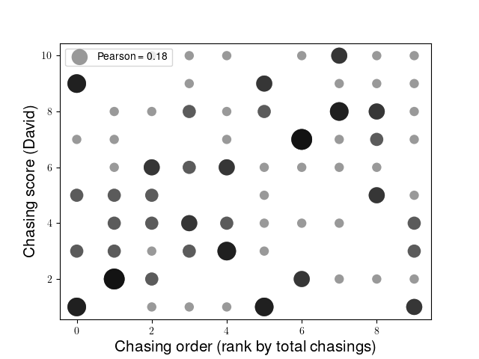
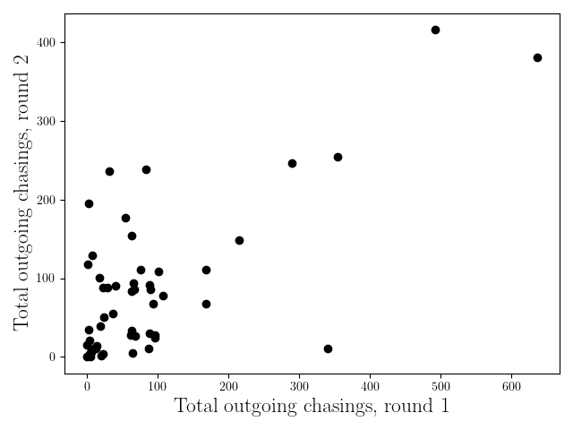
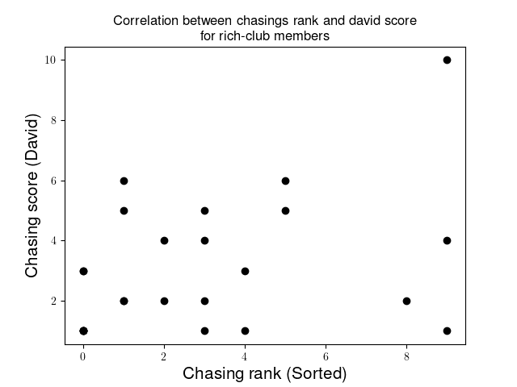
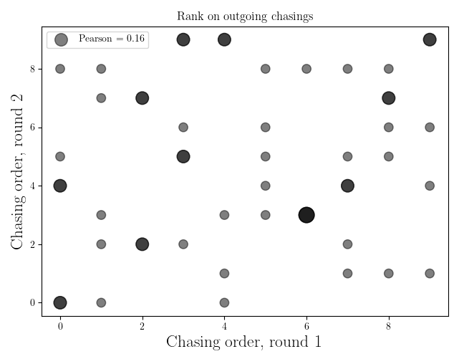

Slide 3
RC & chasing
Averaged as a group, the RC tends to chase a lot (individual differences are present).
Often, one or more members tend to chase a lot (in general), and also show strong directionality, while the others chase less.

Slide 4
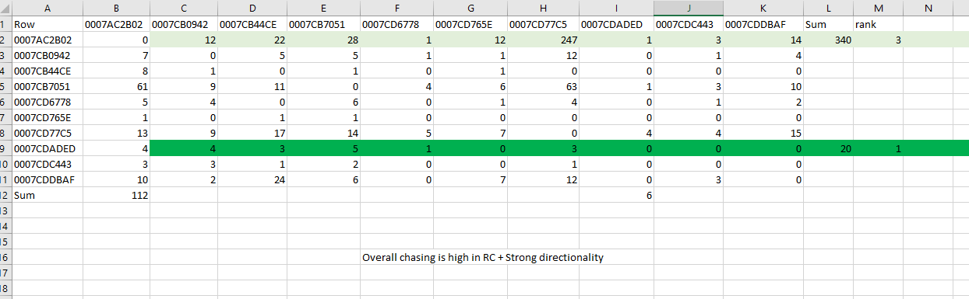
G1
If total number of chasing is higher than mean in group, it “artificially” drives the DS up.
strong directionality

Slide 5
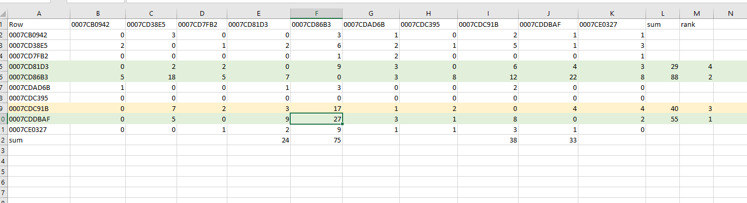
G3
directionality

Slide 6
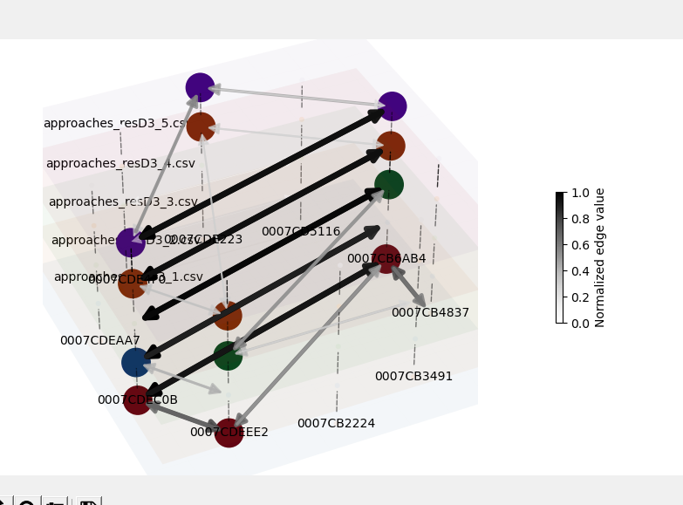
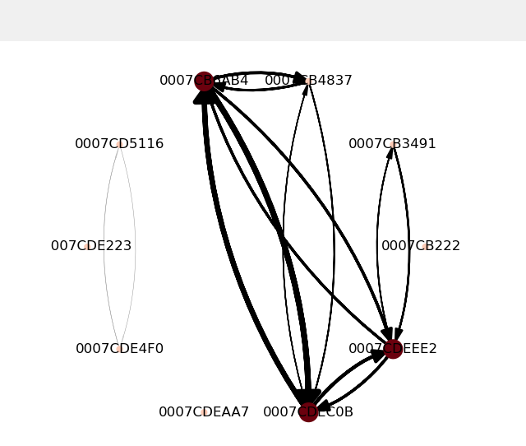
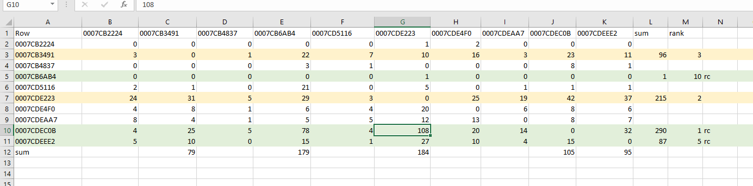
G2
Mutual approaches
What does it mean for 64B4 to be part of the club? Approaches & interactions (not part of club in chasing)
Directionality less clear here

Slide 7
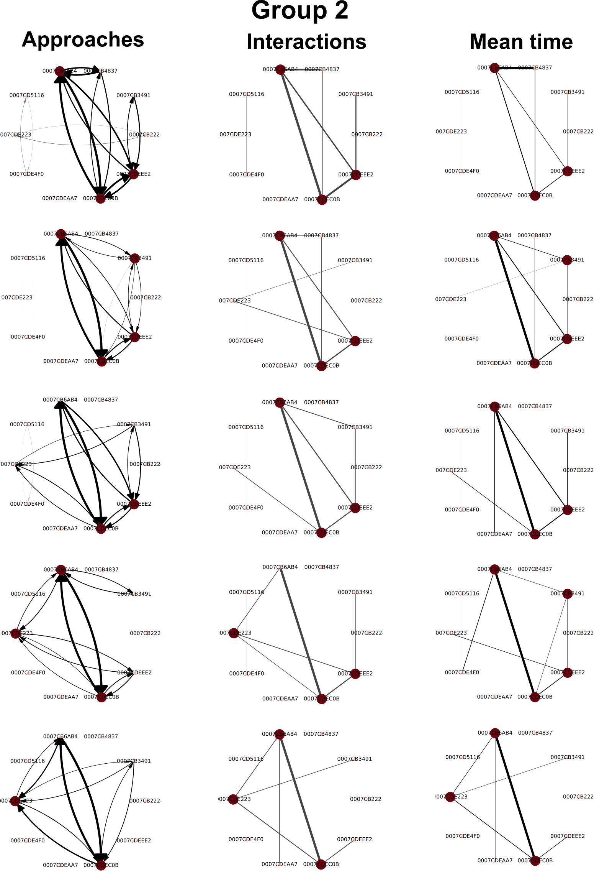

Slide 8
Putting too much emphasis on chasing diminishes the “hidden in data” aspect of the finding.
Maybe we should talk about an average effect? Or on the scale of the group.
Emphasize the effect of stability. Sometimes, RC are not among the top “performers”, but their interactions are stable.

